Slide 2
Topics
Introduction to Inheritance
Polymorphism

Slide 3
Introduction to Inheritance
In the real world, many objects are a specialized version of more general objects
Example: grasshoppers and bees are specialized types of insect
In addition to the general insect characteristics, they have unique characteristics:
Grasshoppers can jump
Bees can sting, make honey, and build hives

Slide 4
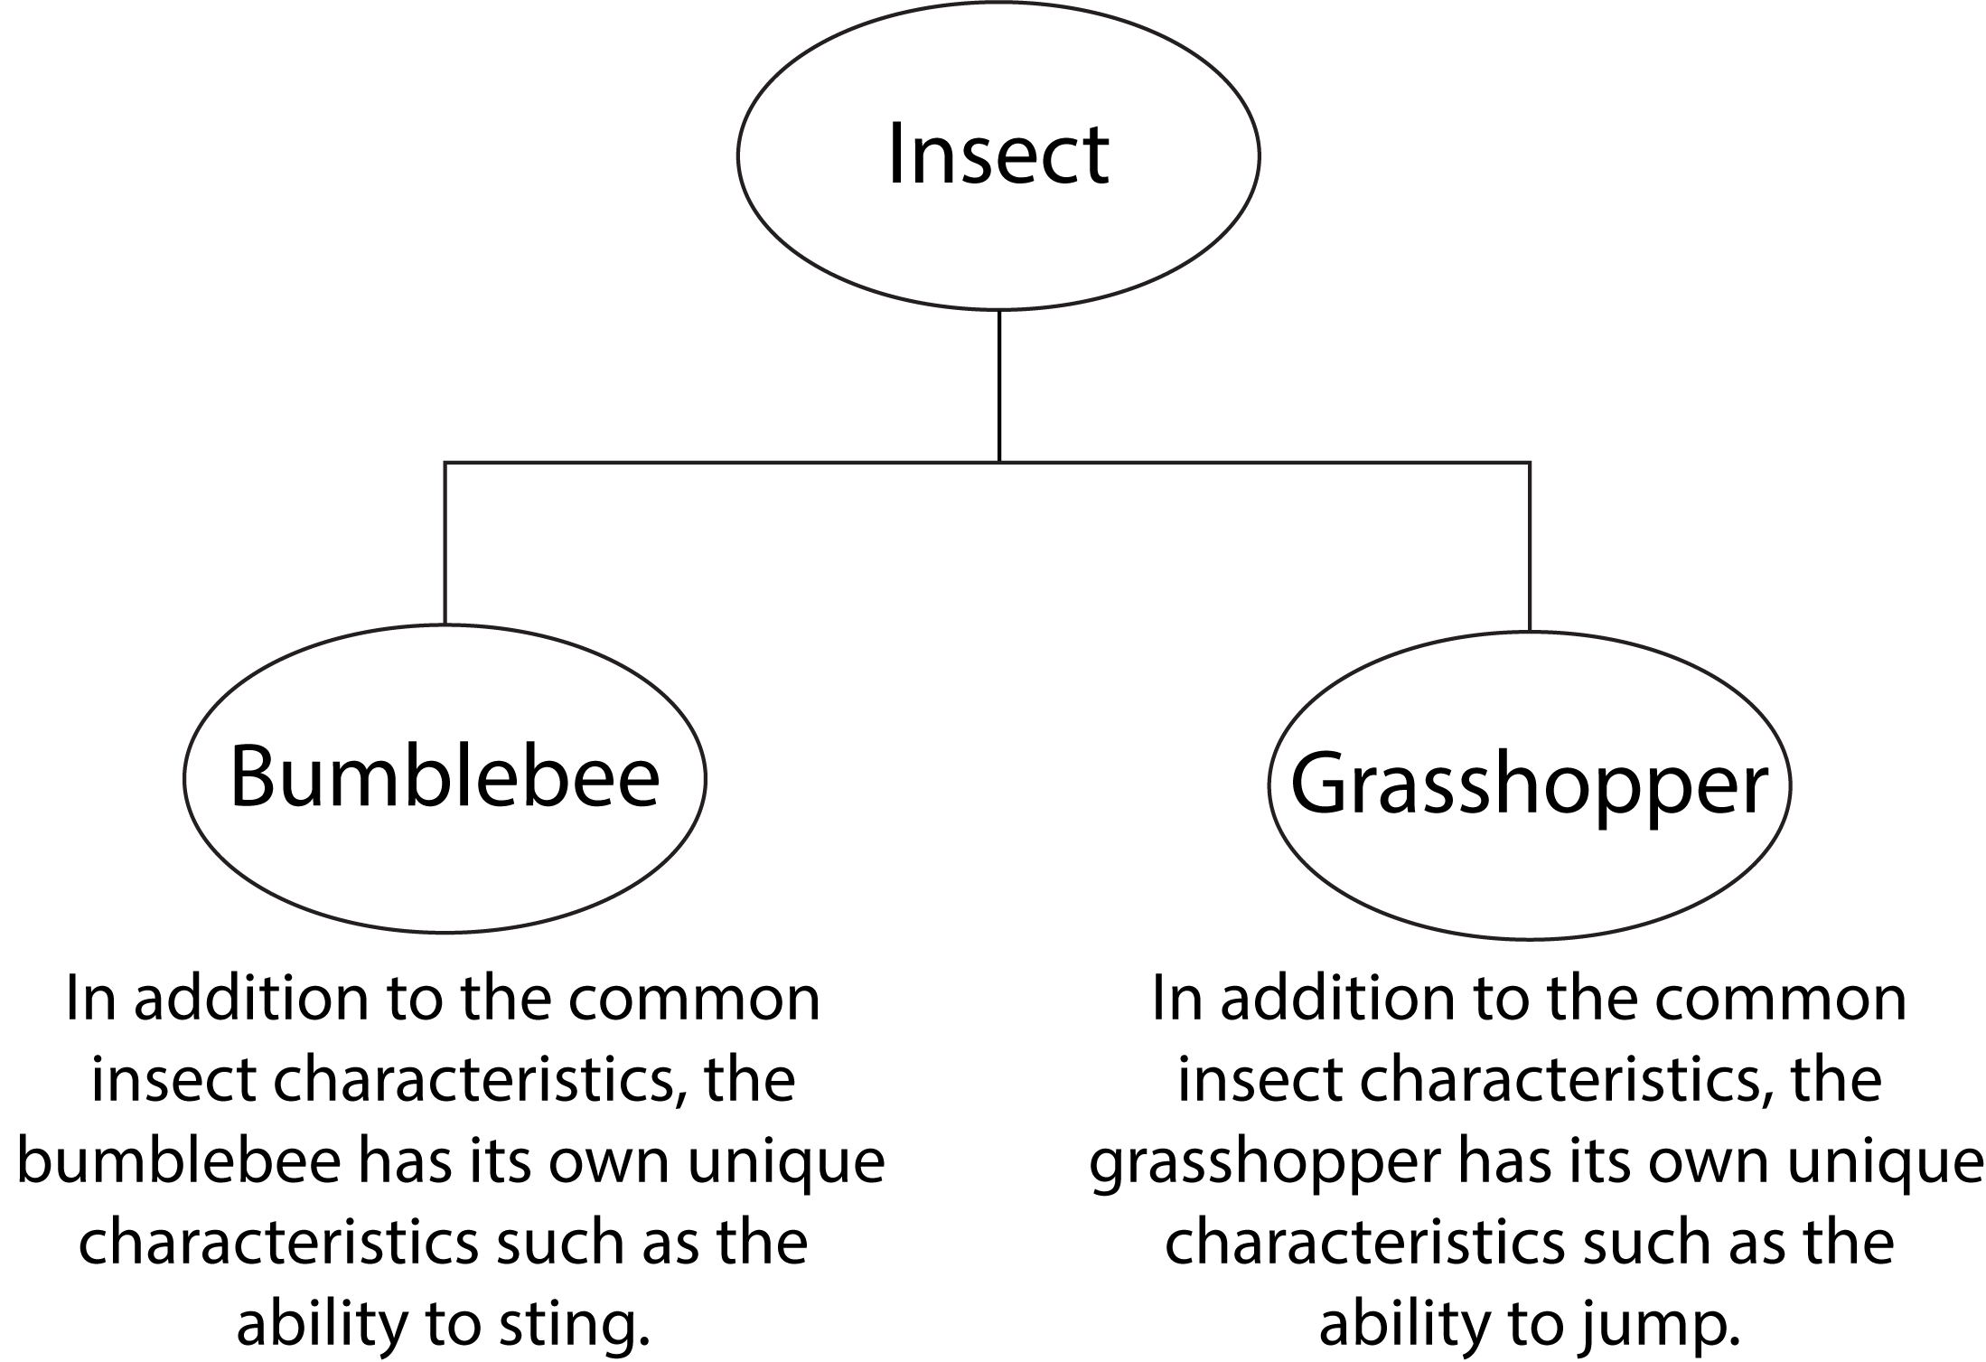
Introduction to Inheritance (cont’d.)

Slide 5
Inheritance and the “Is a” Relationship
“Is a” relationship: exists when one object is a specialized version of another object
Specialized object has all the characteristics of the general object plus unique characteristics
Example: Rectangle is a shape
Daisy is a flower

Slide 6
Inheritance and the “Is a” Relationship (cont’d.)
Inheritance: used to create an “is a” relationship between classes
Superclass (base class): a general class
Subclass (derived class): a specialized class
An extended version of the superclass
Inherits attributes and methods of the superclass
New attributes and methods can be added

Slide 7
Inheritance and the “Is a” Relationship (cont’d.)
For example, need to create classes for cars, pickup trucks, and SUVs
All are automobiles
Have a make, year model, mileage, and price
This can be the attributes for the base class
In addition:
Car has a number of doors
Pickup truck has a drive type
SUV has a passenger capacity

Slide 8
The Automobile Class
class Automobile:
def __init__(self, make, model, mileage, price):
self.__make = make
self.__model = model
self.__mileage = mileage
self.__price = price
def set_make(self, make):
self.__make = make
def set_model(self, model):
self.__model = model
def set_mileage(self, mileage):
self.__mileage = mileage
def set_price(self, price):
self.__price = price
def get_make(self):
return self.__make
def get_model(self):
return self.__model
def get_mileage(self):
return self.__mileage
def get_price(self):
return self.__price

Slide 9
Inheritance and the “Is a” Relationship (cont’d.)
In a class definition for a subclass:
To indicate inheritance, the superclass name is placed in parentheses after subclass name
Example: class Car(Automobile):
The initializer method of a subclass calls the initializer method of the superclass and then initializes the unique data attributes
Add method definitions for unique methods

Slide 10
The Car Class
class Car(Automobile):
def __init__(self, make, model, mileage, price, doors):
Automobile.__init__(self, make, model, mileage, price)
self.__doors = doors
def set_doors(self, doors):
self.__doors = doors
def get_doors(self):
return self.__doors
The Truck Class
class Truck(Automobile):
def __init__(self, make, model, mileage, price, drive_type):
Automobile.__init__(self, make, model, mileage, price)
self.__drive_type = drive_type
def set_drive_type(self, drive_type):
self.__drive = drive_type
def get_drive_type(self):
return self.__drive_type

Slide 11
The SUV Class
class SUV(Automobile):
def __init__(self, make, model, mileage, price, pass_cap):
Automobile.__init__(self, make, model, mileage, price)
self.__pass_cap = pass_cap
def set_pass_cap(self, pass_cap):
self.__pass_cap = pass_cap
def get_pass_cap(self):
return self.__pass_cap

Slide 12
Inheritance in UML Diagrams
In UML diagram, show inheritance by drawing a line with an open arrowhead from subclass to superclass

Slide 13
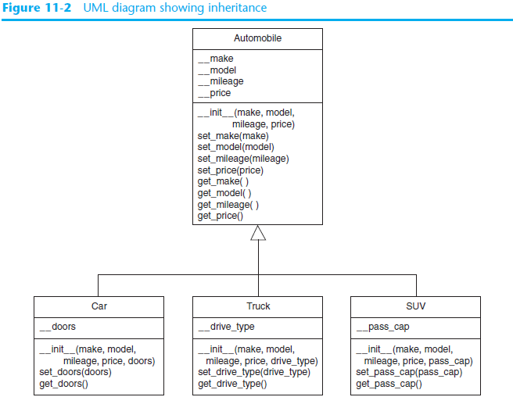

Slide 14
Polymorphism
Polymorphism: an object’s ability to take different forms
Essential ingredients of polymorphic behavior:
Ability to define a method in a superclass and override it in a subclass
Subclass defines method with the same name
Ability to call the correct version of overridden method depending on the type of object that called for it

Slide 15
Polymorphism (cont’d.)
In previous inheritance examples showed how to override the __init__ method
Called superclass __init__ method and then added onto that
The same can be done for any other method
The method can call the superclass equivalent and add to it, or do something completely different

Slide 16
The Mammal, Dog, and Cat Classes (animals.py)
class Mammal:
def __init__(self, species):
self.__species = species
def show_species(self):
print('I am a', self.__species)
def make_sound(self):
print('Grrrrr')
class Dog(Mammal):
def __init__(self):
Mammal.__init__(self, 'Dog')
def make_sound(self):
print('Woof! Woof!')
class Cat(Mammal):
def __init__(self):
Mammal.__init__(self, 'Cat')
def make_sound(self):
print('Meow')

Slide 17
Demonstration of the Mammal, Dog, and Cat Classes
import animals
def main():
mammal = animals.Mammal('regular animal')
dog = animals.Dog()
cat = animals.Cat()
show_mammal_info(mammal)
print()
show_mammal_info(dog)
print()
show_mammal_info(cat)
def show_mammal_info(creature):
creature.show_species()
creature.make_sound()
# Call the main function.
if __name__ == '__main__':
main()
Output
I am a regular animal
Grrrrr
I am a Dog
Woof! Woof!
I am a Cat
Meow

Slide 18
The isinstance Function
Polymorphism provides great flexibility when designing programs
AttributeError exception: raised when a method is receives an object which is not an instance of the right class
isinstance function: determines whether object is an instance of a class
Format: isinstance(object, class)

Slide 19
Summary
This chapter covered:
Inheritance, including:
“Is a” relationships
Subclasses and superclasses
Defining subclasses and initializer methods
Depicting inheritance in UML diagrams
Polymorphism
The isinstance function

